Slide 1
Salesforce1 Lightning
The next generation of building apps, integrating data, and automating business processes

Slide 2
Salesforce1 Lightning
Enter officially sponsored text here…
Oh, but wait! This is a customer/partner driven group! So let’s break this down so we can understand it. Without further ado, I bring you…
LigHTNinG!!!

Slide 3
Salesforce1 Lightning
As cool as a Liger with High-Tech Ninja Gear
Lig H T Nin G

Slide 4
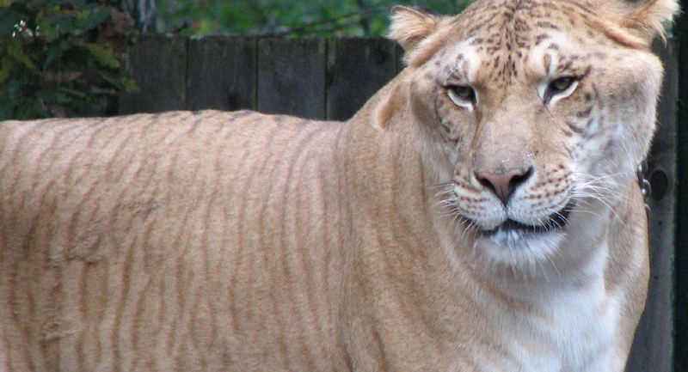

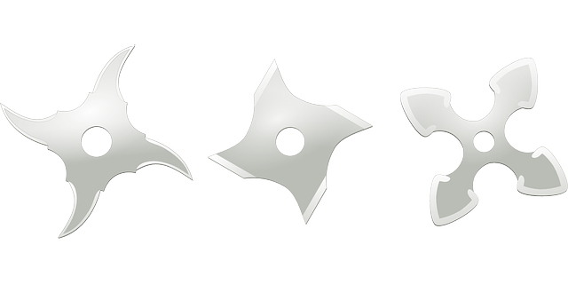
What really is Lightning?
a LIGer!
with High-Tech
NINja Gear!!

Slide 5
What is a Liger?
A mix between a Lion and a Tiger, duh

Slide 6
What is the “LIGer” of Salesforce1 Lightning?
Two thing you are familiar with:
Lion (Workflow [Rules, Field Updates, etc.])
Tiger (Flow [That visual thing that used to have a downloadable desktop manager that went cloud and then got abandoned deprecated improved.

Slide 7
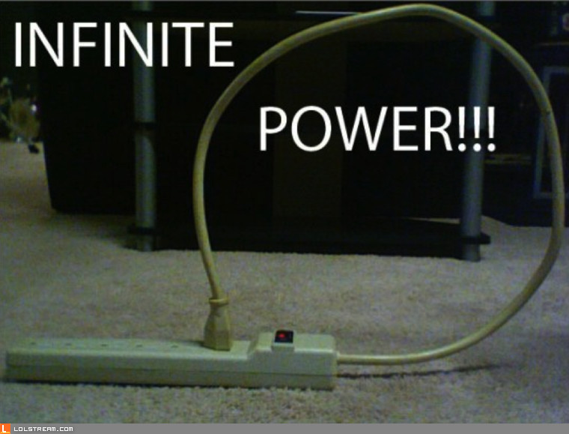
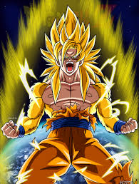
What does this mean for you?
Infinite Power

